Slide 1

Formula 1 LLC
Inventory MANAGEMENT System

Slide 2

Introduction
Audience: The product is for micro to small-scale business, such as the F1 Coffee Roasters.
Goal: improve inventory accuracy, reduce operational costs, and enhance overall business productivity
Differentiators: automates supplier ordering workflows through efficient tracking of stock inventory status and client order consumption.
Web/Mobile: Web Inventory
F1 Coffee Roasters

Slide 3
Use Case #1 Update Stock Product
The Update Stock Product involves fulfilling an order.
Use Case Update Stock Product allows the user of the system to set the specifications of an added product. This includes its initial quantity. This quantity will also be updated if a client order was fulfilled and when the order is restocked.

Slide 4
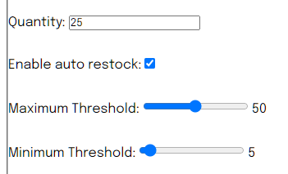
Use case #2: Set stock threshold
Allows users to set stock threshold for each product in the product table.
Attribute to focus on is the max and min settings for this presentation
Using the range sliders; the user can set the thresholds from 0 to 100. Validators were also placed in the logic method, such that the minimum threshold cannot be greater than the maximum.

Slide 5
Front End
HTML, CSS, JavaScript
Express JS Framework
Renders dynamic content
Route different URL paths
Renders views by combining the template with the data

Slide 6
Front End
<% products.forEach(element=> { %>
<tr>
<td>
<%= element.productID %>
</td>
<td>
<%= element.productName %>
</td>
<td>
<%= element.barcode %>
</td>
<td>
<%= element.category %>
</td>
<td>
<%= element.retail %>
</td>
<td>
<%= element.wholesale %>
</td>
<% }) %>
router.get('/setStockProduct/:id', async (req, res) => {
try {
const product = await products.findOne({ _id: req.params.id });
res.render('setStockProduct', { products: product });
} catch (error) {
console.log(error);
}
});

Slide 7
Backend API
Express.js
backend web application framework to simplify development by abstracting away complex and repetitive boilerplate code
freeware and opensource
Routing functions – determine how the web application responds to client request for a URI
Middleware – provide a layer between the request and response objects to allow the backend to modify them
Template engines – provides functionality to allow for the use of static files in a web application that can be rendered and served client-side

Slide 8
Database API
MongoDB
NoSQL database
Relationships of classes were established in the construction of each model
Frequent schema changes
Allows easy insertion of data without needing to alter the fixed schema

Slide 9
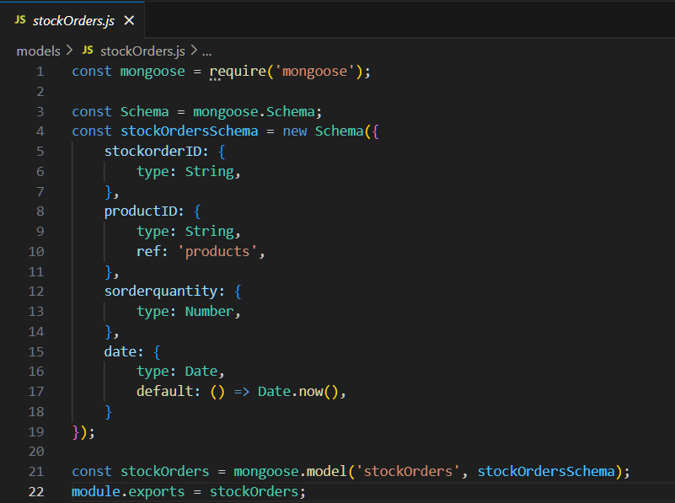
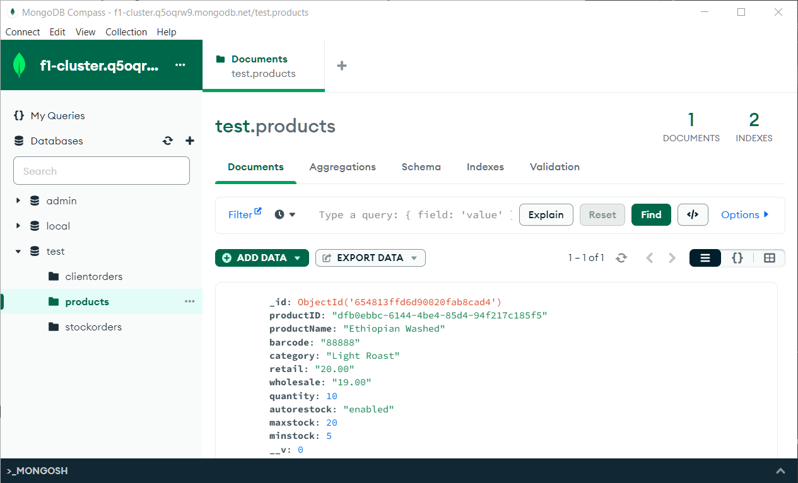
Database API

Slide 10
Chatbot API
Chatbase API: https://docs.chatbase.co/docs (create, message, update, delete, etc.)
Custom GPT with easy of web application embedding by generating HTML code
OpenAI ChatGPT's gpt-3.5-turbo model

Slide 11
Compare it to the Market
This set up can be easily adapted to market
Simplicity and minimal code for maintenance and clarity
Clean project structure
Use of APIs to minimize custom code and facilitate modular programming
Base level chatbot API that allows for improvement as product and revenue grow

Slide 12
DEMO
Demo – A quick demo of all the main/selling features of your product.

